Slide 1
HR scorecord
INTRODUCTION:
OVERVIEW:
The tableau HR scorecard is a frame work designed to measure and evaluate the success of talent management strategies within an organization.
It provides a way for HR professionals and business leaders to track and analyze and key performance.
Indicators related to workforce planning, recruitment, retention and development.

Slide 2
PURPOSE:
Financial perspective: This perspective focuses on the financial impact of HR Initiatives.
Customer perspective: This perspective measures the satisfaction of internal and external customers of HR services.
Internal process perspective: This perspective assesses the effectiveness and efficiency of HR processes.

Slide 3
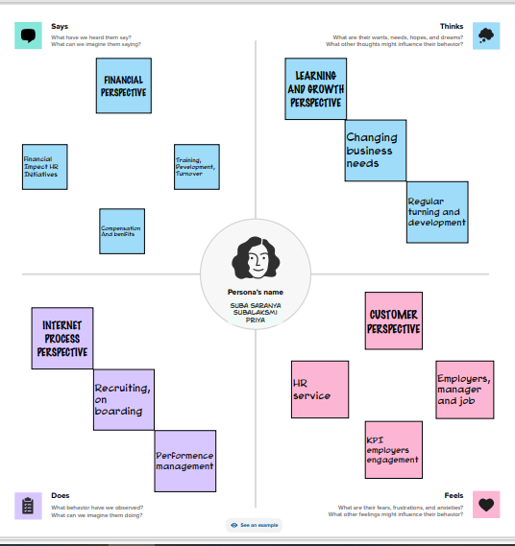
PROBLEM DEFINITION & DESIGN THINKING:
EMPATHY MAP:

Slide 4
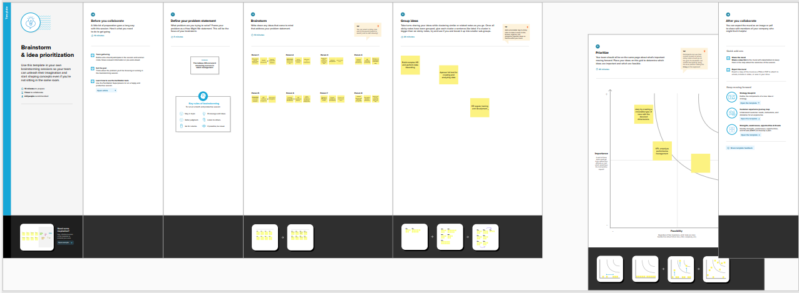
BRAINSTORMING MAP:

Slide 5
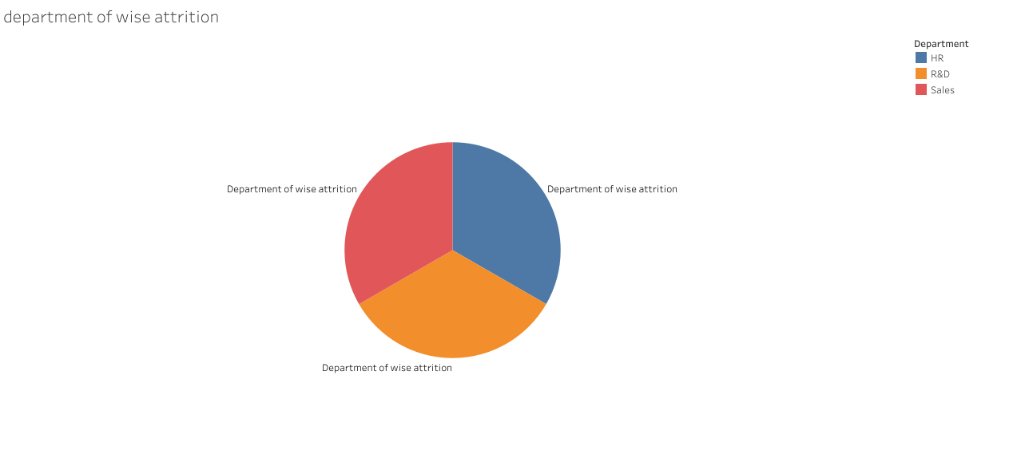
RESULT:

Slide 6
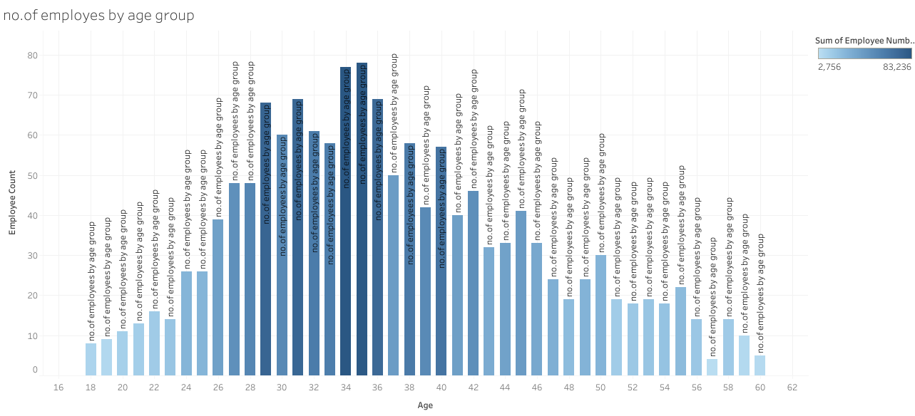

Slide 7
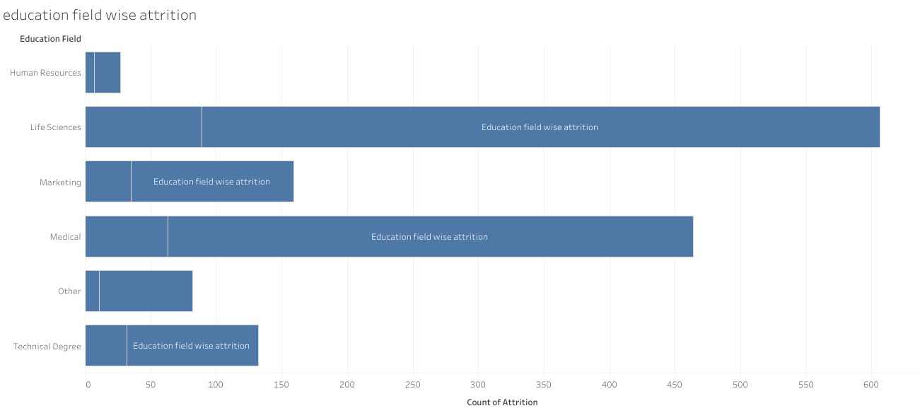

Slide 8
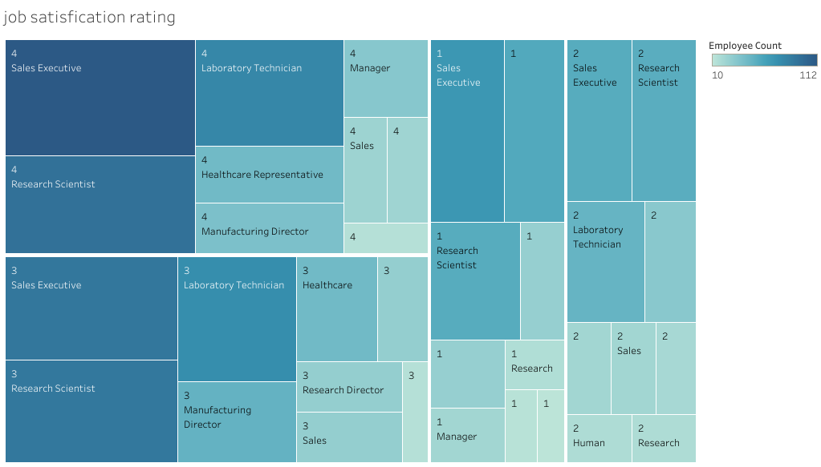

Slide 9
ADVANTAGES & DISADVANTAGES:
Help is ascertaining the right person is deployed in the right position.
Contributes in retaining their top talent.
Better hiring by hiring assessments.
The implementation of talent management program could be expensive in terms of times, resource and financial costs.
Lack of support fro, lines managers can impede the level of commitment from employees.
A core drawback of talent management is, it can contribute in raising the conflicts.
APPLICATIONS:
To measure success effectively, its critical to identify and track relevant key performance indicators for each aspect of talent management.
KPI could include metrics such as employee turnover rates, times to fill position, training completion rates, and employee satisfaction scores.

Slide 10
CONCLUSION:
Department of wise attrition.
No. of employee by age group.
Education field wise attrition.
Job Satisfication rating.
FUTURE SCOPE:
HR will always have a scope in future because it is a field that is constantly changing. HR in the future will be a combination of technology and people analytics.

